Slide 1
Lecture 1

Slide 2
SVD
A form of matrix decomposition (factorization into a product of matrices)
Other forms of matrix decomposition (Eigendecomposition, LU factorization/reduction--should be familiar from Math 54)
In singular value decomposition, the matrix can be written as a sum of rank-1 matrices
A = σ1u1vT1 + σ2u2vT2 + . . . + σnunvT (format later)
Each one of these matrices is a mode.
σ values: (define)

Slide 3
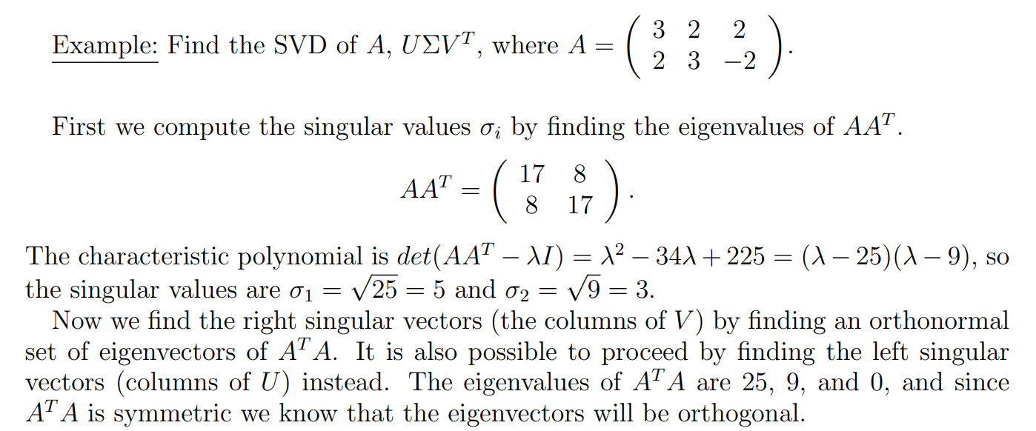
Numerical Example

Slide 4
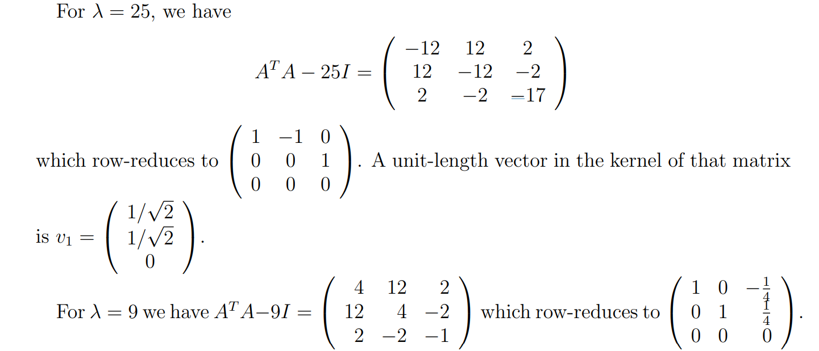

Slide 5
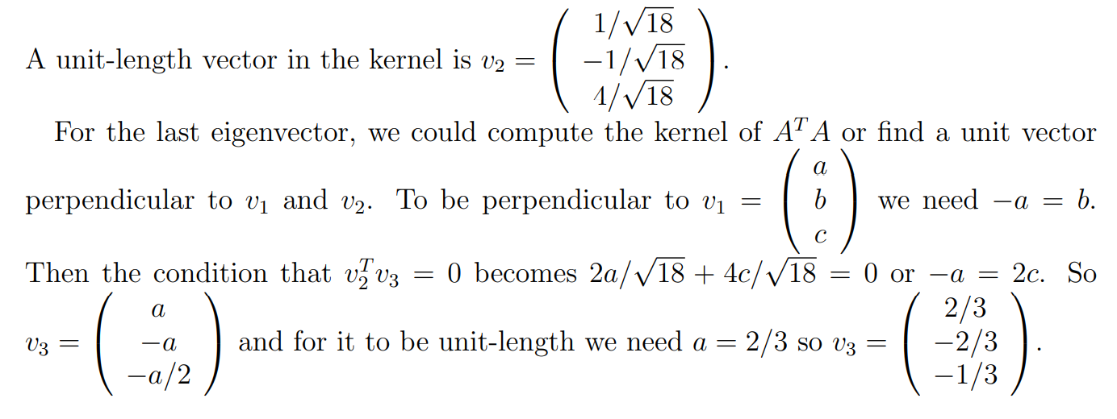

Slide 6
Applications

